Slide 1

Security Policies & Secure Coding in Java
Developer: Abby Farnsworth

Slide 2

OVERVIEW: DEFENSE IN DEPTH

Slide 3
THREATS MATRIX
Likely Insecure coding likely to be exploited | Probable Insecure coding will be probably be violated | Unlikely Insecure coding unlikely to be exploited
High priority High severity, likely, inexpensive to repair | Medium Priority Medium severity, probable, medium cost to repair | Low priority Low severity, unlikely, high cost to repair

Slide 4
10 PRINCIPLES
#1 – Validate Input Data
#2 – Heed Compiler Warnings

Slide 5
10 PRINCIPLES CONT.
#3 – Architect and Design for Security
#4 – Keep it Simple

Slide 6
10 PRINCIPLES CONT.
#5 – Default Deny
#6 – Adhere to the Principle of Least Privilege

Slide 7
10 PRINCIPLES CONT.
#7 – Sanitize Data Sent to Other Systems
#8 – Practice Defense in Depth

Slide 8
10 PRINCIPLES CONT.
#9 – Use Effective Quality Assurance Techniques
#10 – Adopt a Secure Coding Standard

Slide 9
Priority & Threat Level
L3: P1-P4 Low
L2: P6-P9 Medium
L3: P12-P27 High

Slide 10
ENCRYPTION POLICIES
*Encryption in rest
*Encryption at flight
*Encryption in use

Slide 11
TRIPLE-A POLICIES
Authentication – Who are you?
Authorization – What are you allowed to do?
Accounting – What are you doing?

Slide 12
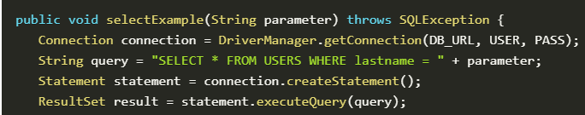
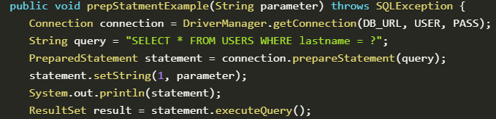
String Injection
Noncompliant code leading to risk of string injection:
Compliant code
Vermeer & Manico, (2019)

Slide 13
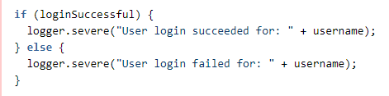
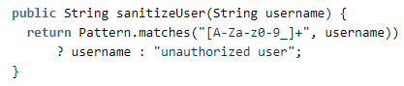
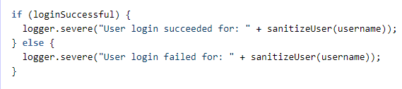
Unsanitized User Input
Noncompliant code
Sanitization function
Compliant code

Slide 14
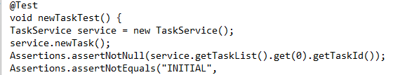
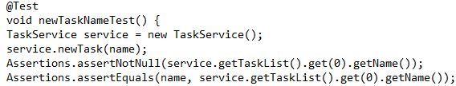
Unit Testing – Assertions
Assert Not Null
Assert Not Equals
Assert Equals

Slide 15

AUTOMATION SUMMARY

Slide 16
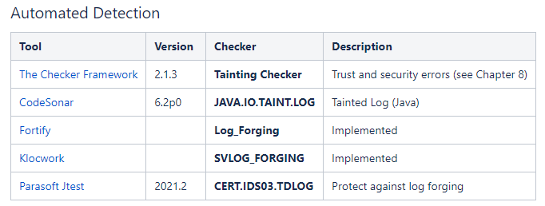
TOOLS
Example of automation tools used for insecure code testing:
SEI CERT Oracle Coding Standard for Java. (2020).

Slide 17
RISKS AND BENEFITS
Adopting security standards
Why act now?
Risk versus reward

Slide 18
RECOMMENDATIONS
Use the SEI CERT Oracle Coding Standard for Java document for a thorough guide on Java secure coding practices.
Keep in mind the SEI Cert is always being updated.
Additional security practices to consider:
Cryptographic practices
Error handling and logging

Slide 19
CONCLUSION
Building stronger, more secure software requires the adoption of secure policies and standards.

Slide 20
REFERENCES
Vermeer, B. & Manico, J. (Sep 2019). 10 Java security best practices. Retrieved from https://snyk.io/blog/10-java-security-best-practices/
SEI CERT C++ Coding Standard. (2020). Retrieved from https://wiki.sei.cmu.edu/confluence/pages/viewpage.action?pageId=88046682

